Slide 1

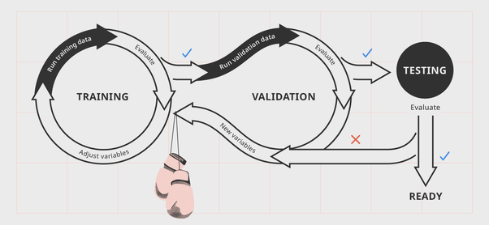
BTech(CSE) III Year V Semester Session 2025-26 BCSE0005: Machine Learning
Training and Testing, Evaluation
Dr. Dilip Kumar Sharma
PhD CSE IIT DHN, SM(IEEE, ACM, CSI), Fellow IETE, Fellow IE(I)
Professor- Dept. of Computer Engineering & Applications
Dean ( International Relations and Academic Collaboration)
GLA University, Mathura
dilip.sharma@gla.ac.in

Slide 2
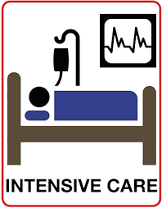
An Example Application
An emergency room in a hospital measures 17 variables (e.g., blood pressure, age, etc) of newly admitted patients.
A decision is needed: whether to put a new patient in an Intensive-Care Unit (ICU).
Due to the high cost of ICU, those patients who may survive less than a month are given higher priority.
Problem: to predict high-risk patients and discriminate them from low-risk patients.

Slide 3
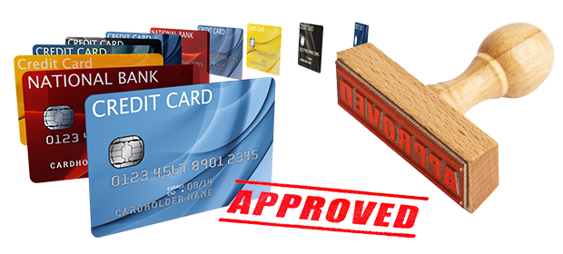
Another Application
A credit card company receives thousands of applications for new cards. Each application contains information about an applicant,
age
Marital status
annual salary
outstanding debts
credit rating
etc.
Problem: To decide whether an application should approved, or to classify applications into two categories, approved and not approved.

Slide 4
Overview
Like human learning from past experiences.
But, A computer does not have “experiences”.
A computer system learns from data, which represent some “past experiences” of an application domain.
Our focus: learn a target function that can be used to predict the values of a discrete class attribute, e.g., approve or not-approved, and high-risk or low risk.
The task is commonly called: Supervised learning, classification, or inductive learning.

Slide 5
Overview …
Data: A set of data records (also called examples, instances or cases) described by
k attributes: A₁, A₂, … A_{k}.
a class: Each example is labelled with a pre-defined class.
Goal: To learn a classification model from the data that can be used to predict the classes of new (future, or test) cases/instances.

Slide 6
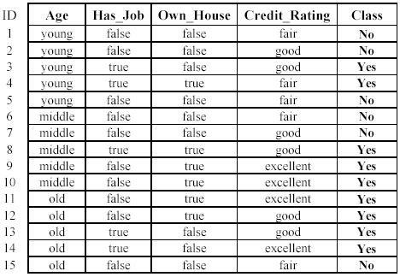
An example: data (loan application)
Approved or not

Slide 7
An example: the learning task
Learn a classification model from the data
Use the model to classify future loan applications into
Yes (approved) and
No (not approved)
What is the class for following case/instance?

Slide 8
Question 1: In the context of supervised learning, what is the main objective when training a machine learning model using historical data?
Options: A. To generate random predictions for future data B. To learn a target function that predicts a class label based on input attributes C. To cluster similar data points into different groups D. To clean and store the data efficiently
Correct Answer: B. To learn a target function that predicts a class label based on input attributes
Question 2: A hospital wants to predict whether newly admitted patients should be placed in the ICU. The system uses 17 measured variables to make this decision, with a focus on identifying high-risk patients. This task is an example of:
Options: A. Unsupervised learning B. Clustering C. Supervised learning or classification D. Reinforcement learning
Correct Answer: C. Supervised learning or classification

Slide 9
Overview …
Supervised vs. Unsupervised Learning
Supervised learning: classification is seen as supervised learning from examples.
Supervision: The data (observations, measurements, etc.) are labeled with pre-defined classes.
Test data are classified into these classes too.
Unsupervised learning (clustering)
Class labels of the data are unknown
Given a set of data, the task is to establish the existence of classes or clusters in the data

Slide 10
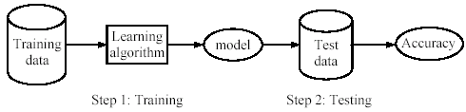
Overview …
Supervised learning process: two steps
Learning (training): Learn a model using the training data
Testing: Test the model using unseen test data to assess the model accuracy

Slide 11
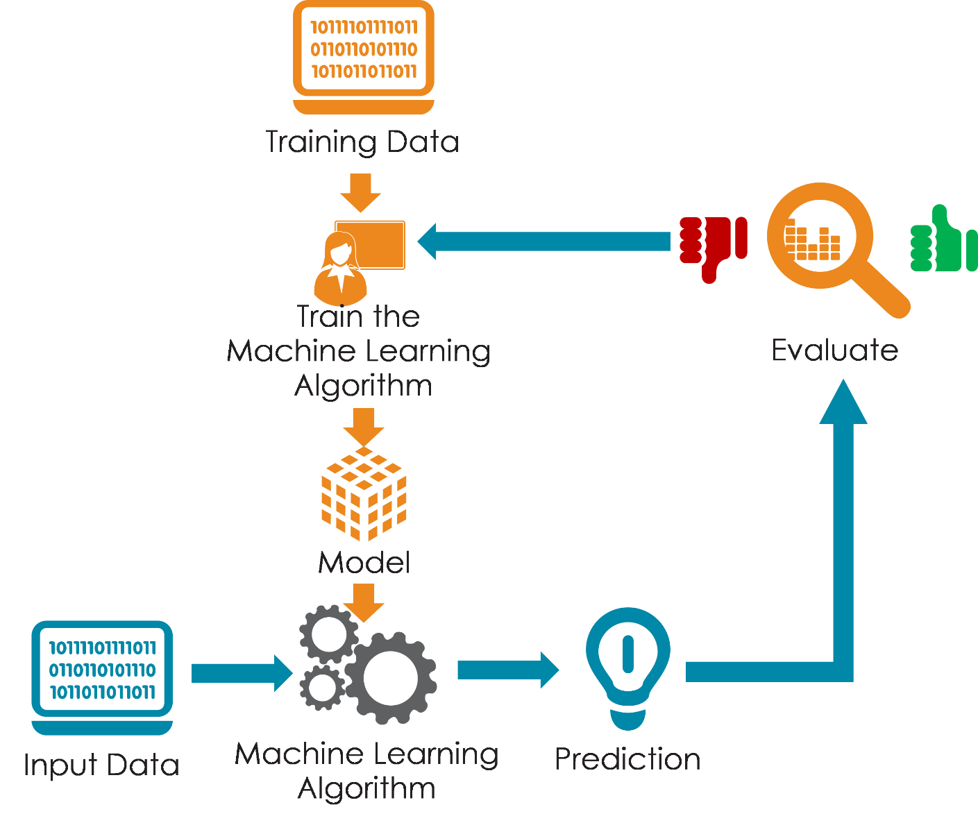
Overview …
Supervised learning process: two steps

Slide 12

Evaluation Methods
The available data set D is divided into two disjoint subsets,
the training set D_{train} (for learning a model)
the test set D_{test} (for testing the model)
Important: training set should not be used in testing and the test set should not be used in learning.
Unseen test set provides a unbiased estimate of accuracy.

Slide 13
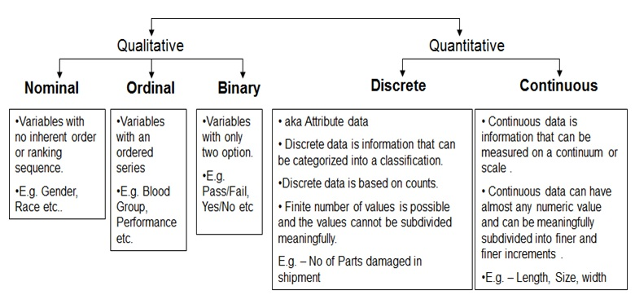
Levels of Measurement of Data

Slide 14
Evaluation Methods …
Validation set: the available data is divided into three subsets,
a training set,
a validation set and
a test set.
A validation set is used frequently for estimating parameters in learning algorithms.
In such cases, the values that give the best accuracy on the validation set are used as the final parameter values.
Cross-validation can be used for parameter estimating as well.

Slide 15
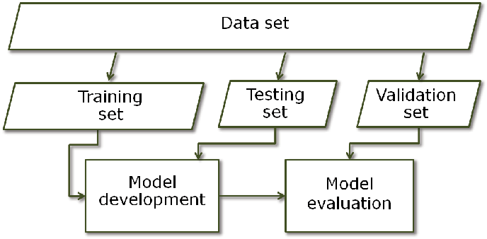
Evaluation Methods …

Slide 16
Question 1: Why is it important that the training set and test set in a supervised learning task are disjoint (non-overlapping)?
Options: A. To avoid data duplication B. To ensure faster processing C. To provide an unbiased estimate of the model's performance D. To increase the size of the dataset artificially
Correct Answer: C. To provide an unbiased estimate of the model's performance
Question 2: In a machine learning workflow involving a training, validation, and test set, what is the main role of the validation set?
Options: A. To measure final model accuracy B. To train the model with additional data C. To tune the model’s parameters for best performance D. To randomly shuffle test cases
Correct Answer: C. To tune the model’s parameters for best performance

Slide 17
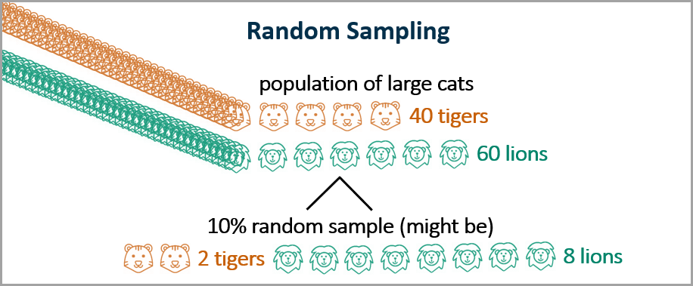
Partitioning the Data
Simple random sampling: The observations selected for the subset of the data are randomly selected, i.e., each observation has an equal probability of being chosen.

Slide 18
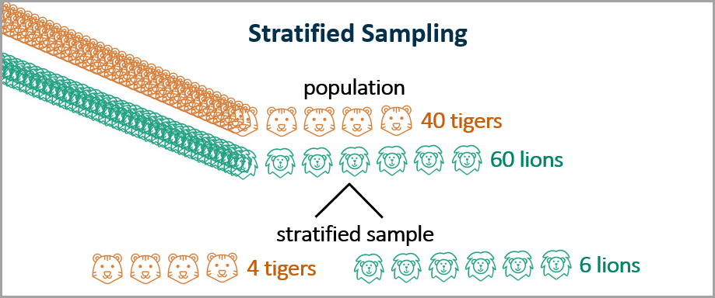
Partitioning the Data
Stratified sampling: The data are divided into segments or “strata,” and then observations are randomly selected from each stratum.

Slide 19
Partitioning the Data
Oversampling
Oversampling is commonly used when you are looking at rare events, such as cancer cases. You may have a data set with 10,000 people and only 100 cancer cases.
You may wish to oversample the cancer cases to get, for example, a 90:10 ratio of non-cancer to cancer cases. You could use all of the cancer cases (all 100) and a 9% random sample of the non-cancer cases (900).

Slide 20
Evaluation Methods: Cross Validation
k-fold cross-validation: The available data is partitioned into k equal-size disjoint subsets.
Use each subset as the test set and combine the rest k-1 subsets as the training set to learn a classifier.
The procedure is run k times, which give k accuracies.
The final estimated accuracy of learning is the average of the k accuracies.
10-fold and 5-fold cross-validations are commonly used.
This method is used when the available data is not large.

Slide 21
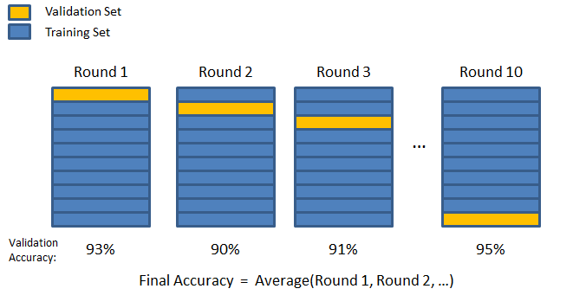
Evaluation Methods: Cross Validation

Slide 22
Evaluation Methods: Cross Validation …
cross-validation generates an approximate estimate of how well the learned model will do on “unseen” data
by averaging over different partitions it is more robust than just a single train/validate partition of the data
“k-fold” cross-validation is a generalization
partition data into disjoint validation subsets of size n/k
train, validate, and average over the v partitions
e.g., k=10 is commonly used
k-fold cross-validation is approximately k times computationally more expensive than just fitting a model to all of the data

Slide 23
Question 1: In a medical dataset with a very small proportion of cancer cases (1%), which data partitioning technique is most appropriate to ensure the model learns to identify rare events effectively?
Options: A. Simple random sampling B. Stratified sampling C. Oversampling D. 10-fold cross-validation
Correct Answer: C. Oversampling
Question 2: Which of the following statements best explains why k-fold cross-validation is preferred over a single train-test split, especially when data is limited?
Options: A. It uses only one fold for training to reduce overfitting B. It reduces computational cost by using smaller data chunks C. It provides a more robust and reliable estimate of model performance by averaging over multiple test sets D. It trains multiple models on overlapping data for higher accuracy
Correct Answer: C. It provides a more robust and reliable estimate of model performance by averaging over multiple test sets

Slide 24
Metrics to Evaluate Machine Learning Algorithm
Predictive accuracy
Efficiency
time to construct the model
time to use the model
Robustness: handling noise and missing values
Scalability: efficiency in disk-resident databases
Interpretability:
understandable and insight provided by the model
Compactness of the model: size of the tree, or the number of rules.

Slide 25
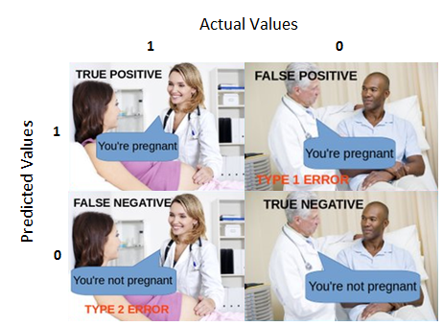

Slide 26
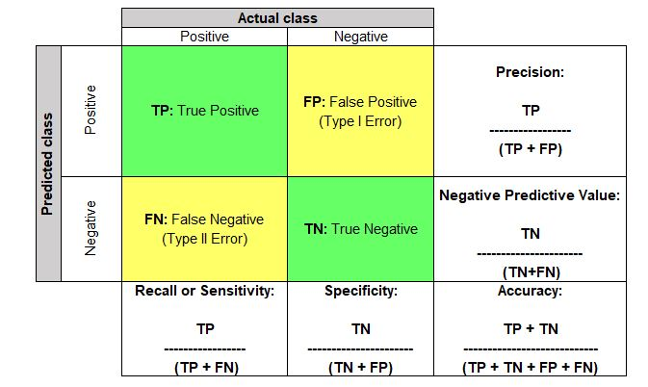

Slide 27
Metrics to Evaluate Machine Learning Algorithm …
 | Actual: Class = Yes | Actual: Class = No
Predicted: Class =Yes | True Positive | False Positive
Predicted: Class = No | False Negative | True Negative
Confusion
Matrix
Where,
True Positive (TP): The number of correct classifications of the positive examples
False Negative (FN): The number of incorrect classifications of the positive examples
False Positive (FP): The number of incorrect classifications of the negative examples
True Negative (TN): The number of correct classifications of the negative examples

Slide 28
Precision and Recall Measures
Precision p is the number of correctly classified positive examples divided by the total number of examples that are classified as positive.
Recall r is the number of correctly classified positive examples divided by the total number of actual positive examples in the test set.
Notes:
If you label every email to be spam, you will have a recall of 1. Why? Because you are predicting an email is spam. There’s no way you can use False Negatives since you are not predicting that an email would be non-spam. However, you will also be incorrectly predicting spam emails as non-spam.
If you predict that one email is spam, and you get that right, then you’re precision would be 1. Why? Because there are not false positives. However, you will be missing a lot of predictions.

Slide 29
F1-value (also called F1-score)
It is hard to compare two classifiers using two measures. F₁ score combines precision and recall into one measure
The F score is used to measure a test’s accuracy
F1 Score is the weighted average (harmonic mean) of Precision and Recall.
The F score reaches the best value, meaning perfect precision and recall, at a value of 1. The worst F score, which means lowest precision and lowest recall, would be a value of 0.
Notes:
F1 is usually more useful than accuracy, especially if you have an uneven class distribution. Accuracy works best if false positives and false negatives have similar cost. If the cost of false positives and false negatives are very different, it’s better to look at both Precision and Recall. In our case, F1 score is 0.701.

Slide 30
Question 1: Which of the following statements best describes precision in the context of evaluating a machine learning classifier?
Options: A. It measures the proportion of correctly classified examples out of all actual positives B. It measures the proportion of correctly classified positives among all predicted positives C. It measures how fast the model runs on large datasets D. It indicates the size and interpretability of the model
Correct Answer: B. It measures the proportion of correctly classified positives among all predicted positives
Question 2: Why is the F1-score often preferred over using precision and recall separately when comparing classification models?
Options: A. Because it only considers true negatives B. Because it balances the trade-off between training and testing time C. Because it provides a single metric that balances both precision and recall D. Because it measures interpretability of the model
Correct Answer: C. Because it provides a single metric that balances both precision and recall

Slide 31
Assignment
Given the confusion matrix, find:
Classification Accuracy, Recall, Precision, F-measure
N=165 |  | Predicted
 |  | yes | no
Actual | yes | 100 | 5 | 105
 | no | 10 | 50 | 60
 |  | 110 | 55

Slide 32

Assignment
Given the confusion matrix, find:
Classification Accuracy, Recall, Precision, F-measure
N=165 |  | Predicted
 |  | yes | no
Actual | yes | 100 | 5 | 105
 | no | 10 | 50 | 60
 |  | 110 | 55
$$Precision=$$

Slide 33

Assignment
Given the confusion matrix, find:
Classification Accuracy, Recall, Precision, F-measure
N=165 |  | Predicted
 |  | yes | no
Actual | yes | 100 | 5 | 105
 | no | 10 | 50 | 60
 |  | 110 | 55
$Precision= \frac{tp}{tp+fp}$ =

Slide 34

Assignment
Given the confusion matrix, find:
Classification Accuracy, Recall, Precision, F-measure
N=165 |  | Predicted
 |  | yes | no
Actual | yes | 100 | 5 | 105
 | no | 10 | 50 | 60
 |  | 110 | 55
$Precision= \frac{tp}{tp+fp}$ = $\frac{100}{100+10}$

Slide 35

Assignment
Given the confusion matrix, find:
Classification Accuracy, Recall, Precision, F-measure
N=165 |  | Predicted
 |  | yes | no
Actual | yes | 100 | 5 | 105
 | no | 10 | 50 | 60
 |  | 110 | 55
$Precision= \frac{tp}{tp+fp}$ = $\frac{100}{100+10}=\frac{100}{110}$

Slide 36


Assignment
Given the confusion matrix, find:
Classification Accuracy, Recall, Precision, F-measure
N=165 |  | Predicted
 |  | yes | no
Actual | yes | 100 | 5 | 105
 | no | 10 | 50 | 60
 |  | 110 | 55
$Precision= \frac{tp}{tp+fp}$ = $\frac{100}{100+10}=\frac{100}{110}$
$$Recall=$$

Slide 37
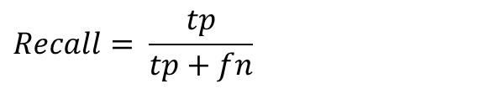
Assignment
Given the confusion matrix, find:
Classification Accuracy, Recall, Precision, F-measure
N=165 |  | Predicted
 |  | yes | no
Actual | yes | 100 | 5 | 105
 | no | 10 | 50 | 60
 |  | 110 | 55
$Precision= \frac{tp}{tp+fp}$ = $\frac{100}{100+10}=\frac{100}{110}$
$$Recall= \frac{tp}{tp+fn}$$

Slide 38
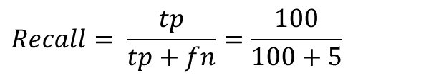
Assignment
Given the confusion matrix, find:
Classification Accuracy, Recall, Precision, F-measure
N=165 |  | Predicted
 |  | yes | no
Actual | yes | 100 | 5 | 105
 | no | 10 | 50 | 60
 |  | 110 | 55
$Precision= \frac{tp}{tp+fp}$ = $\frac{100}{100+10}=\frac{100}{110}$
$$Recall= \frac{tp}{tp+fn}=\frac{100}{100+5}$$

Slide 39

Assignment
Given the confusion matrix, find:
Classification Accuracy, Recall, Precision, F-measure
N=165 |  | Predicted
 |  | yes | no
Actual | yes | 100 | 5 | 105
 | no | 10 | 50 | 60
 |  | 110 | 55
$Precision= \frac{tp}{tp+fp}$ = $\frac{100}{100+10}=\frac{100}{110}$
$Recall= \frac{tp}{tp+fn}=\frac{100}{100+5}=$ $\frac{100}{105}$

Slide 40

Assignment
Given the confusion matrix, find:
Classification Accuracy, Recall, Precision, F-measure
N=165 |  | Predicted
 |  | yes | no
Actual | yes | 100 | 5 | 105
 | no | 10 | 50 | 60
 |  | 110 | 55
$Precision= \frac{tp}{tp+fp}$ = $\frac{100}{100+10}=\frac{100}{110}$
$Recall= \frac{tp}{tp+fn}=\frac{100}{100+5}=$ $\frac{100}{105}$
$$Accuracy=$$

Slide 41

Assignment
Given the confusion matrix, find:
Classification Accuracy, Recall, Precision, F-measure
N=165 |  | Predicted
 |  | yes | no
Actual | yes | 100 | 5 | 105
 | no | 10 | 50 | 60
 |  | 110 | 55
$Precision= \frac{tp}{tp+fp}$ = $\frac{100}{100+10}=\frac{100}{110}$
$Recall= \frac{tp}{tp+fn}=\frac{100}{100+5}=$ $\frac{100}{105}$
$Accuracy=$ $\frac{tp+tn}{tp+fp+fn+tn}$

Slide 42

Assignment
Given the confusion matrix, find:
Classification Accuracy, Recall, Precision, F-measure
N=165 |  | Predicted
 |  | yes | no
Actual | yes | 100 | 5 | 105
 | no | 10 | 50 | 60
 |  | 110 | 55
$Precision= \frac{tp}{tp+fp}$ = $\frac{100}{100+10}=\frac{100}{110}$
$Recall= \frac{tp}{tp+fn}=\frac{100}{100+5}=$ $\frac{100}{105}$
$Accuracy=$ $\frac{tp+tn}{tp+fp+fn+tn}$ $= \frac{100+50}{100+5+10+50}$

Slide 43

Assignment
Given the confusion matrix, find:
Classification Accuracy, Recall, Precision, F-measure
N=165 |  | Predicted
 |  | yes | no
Actual | yes | 100 | 5 | 105
 | no | 10 | 50 | 60
 |  | 110 | 55
$Precision= \frac{tp}{tp+fp}$ = $\frac{100}{100+10}=\frac{100}{110}$
$Recall= \frac{tp}{tp+fn}=\frac{100}{100+5}=$ $\frac{100}{105}$
$Accuracy=$ $\frac{tp+tn}{tp+fp+fn+tn}$ $= \frac{100+50}{100+5+10+50}= \frac{150}{165}$

Slide 44
Assignment
Given the confusion matrix, find:
Classification Accuracy, Recall, Precision, F-measure
N=165 |  | Predicted
 |  | yes | no
Actual | yes | 100 | 5 | 105
 | no | 10 | 50 | 60
 |  | 110 | 55
$Precision= \frac{tp}{tp+fp}$ = $\frac{100}{100+10}=\frac{100}{110}$
$Recall= \frac{tp}{tp+fn}=\frac{100}{100+5}=$ $\frac{100}{105}$
$Accuracy=$ $\frac{tp+tn}{tp+fp+fn+tn}$ $= \frac{100+50}{100+5+10+50}= \frac{150}{165}$

Slide 45

Assignment
Given the confusion matrix, find:
Classification Accuracy, Recall, Precision, F-measure
N=165 |  | Predicted
 |  | yes | no
Actual | yes | 100 | 5 | 105
 | no | 10 | 50 | 60
 |  | 110 | 55
$Precision= \frac{tp}{tp+fp}$ = $\frac{100}{100+10}=\frac{100}{110}$
$Recall= \frac{tp}{tp+fn}=\frac{100}{100+5}=$ $\frac{100}{105}$
$Accuracy=$ $\frac{tp}{tp+fp+fn+tn}$ $= \frac{100}{100+5+10+50}= \frac{100}{165}$
$$F−measure=$$

Slide 46

Assignment
Given the confusion matrix, find:
Classification Accuracy, Recall, Precision, F-measure
N=165 |  | Predicted
 |  | yes | no
Actual | yes | 100 | 5 | 105
 | no | 10 | 50 | 60
 |  | 110 | 55
$Precision= \frac{tp}{tp+fp}$ = $\frac{100}{100+10}=\frac{100}{110}$
$Recall= \frac{tp}{tp+fn}=\frac{100}{100+5}=$ $\frac{100}{105}$
$Accuracy=$ $\frac{tp}{tp+fp+fn+tn}$ $= \frac{100}{100+5+10+50}= \frac{100}{165}$
$F−measure=$ $\frac{2 ∗precision∗recall}{precision+recall}$

Slide 47

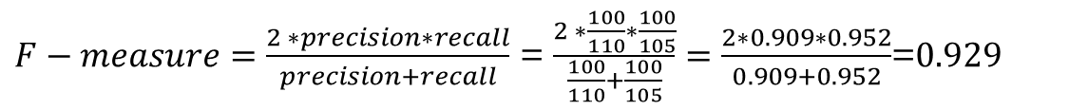

Assignment
Given the confusion matrix, find:
Classification Accuracy, Recall, Precision, F-measure
N=165 |  | Predicted
 |  | yes | no
Actual | yes | 100 | 5 | 105
 | no | 10 | 50 | 60
 |  | 110 | 55
$Precision= \frac{tp}{tp+fp}$ = $\frac{100}{100+10}=\frac{100}{110}=0.909$
$Recall= \frac{tp}{tp+fn}=\frac{100}{100+5}=$ $\frac{100}{105}=0.952$
$Accuracy=$ $\frac{tp+tn}{tp+fp+fn+tn}$ $= \frac{100+50}{100+5+10+50}= \frac{150}{165}=0.909$
$F−measure=$ $\frac{2 ∗precision∗recall}{precision+recall}$ = $\frac{2 ∗\frac{100}{110}∗\frac{100}{105}}{\frac{100}{110}+\frac{100}{105}}=\frac{2∗0.909∗0.952}{0.909+0.952}$=$0.929$

Slide 48
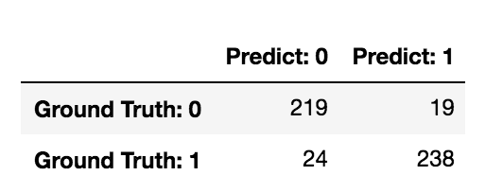
Assignment
Given the confusion matrix, find:
Classification Accuracy, Recall, Precision, F-measure

Slide 49


$Precision= \frac{tp}{tp+fp}$ $=\frac{238}{238+19}=0.926$
$Recall= \frac{tp}{tp+fn}$ $=\frac{238}{238+24}=0.908$
$Accuracy= \frac{tp+tn}{tp+tn+fp+fn}$ $=\frac{238+219}{238+219+19+24}=0.914$
$f_{1} score= \frac{2∗Precision∗Recall}{Precision+Recall}$ $=\frac{2∗0.926∗0.908}{0.926+0.908}=0.916$

Slide 50


Receiver Operating Characteristics Curve
An ROC curve (receiver operating characteristic curve) is a graph showing the performance of a classification model at all classification thresholds.
It is a plot of the True Positive Rate (TPR) against the False Positive Rate (FPR).
True Positive Rate (TPR) :
False Positive Rate (FPR):

Slide 51
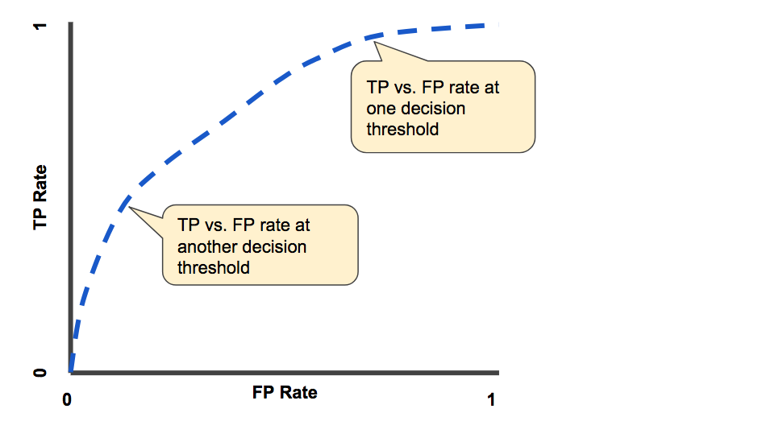
Receiver Operating Characteristics Curve
TP Vs. FP rate at different classification thresholds

Slide 52
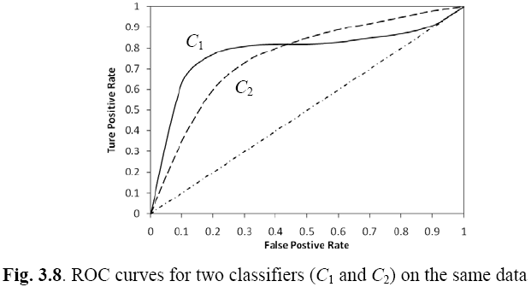
Example ROC curves
ROC cuvers for two classifiers (C1 and C2) on the same data

Slide 53
Area Under the Curve (AUC)
Which classifier is better, C₁ or C₂?
It depends on which region you talk about.
Can we have one measure?
Yes, we compute the area under the curve (AUC)
If AUC for C_{i} is greater than that of C_{j}, it is said that C_{i} is better than C_{j}.
If a classifier is perfect, its AUC value is 1
If a classifier makes all random guesses, its AUC value is 0.5.

Slide 54


Sensitivity and Specificity
In statistics, there are two other evaluation measures:
Sensitivity: Same as TPR
Specificity: Also called True Negative Rate (TNR)
Then we have

Slide 55
Summary

Slide 56
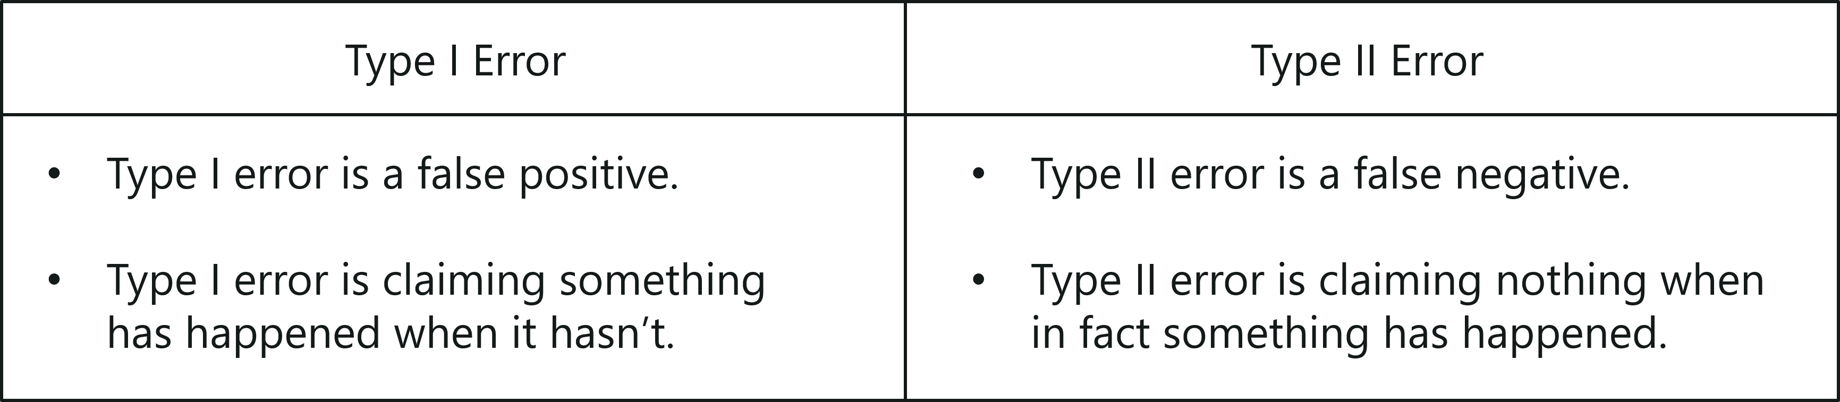
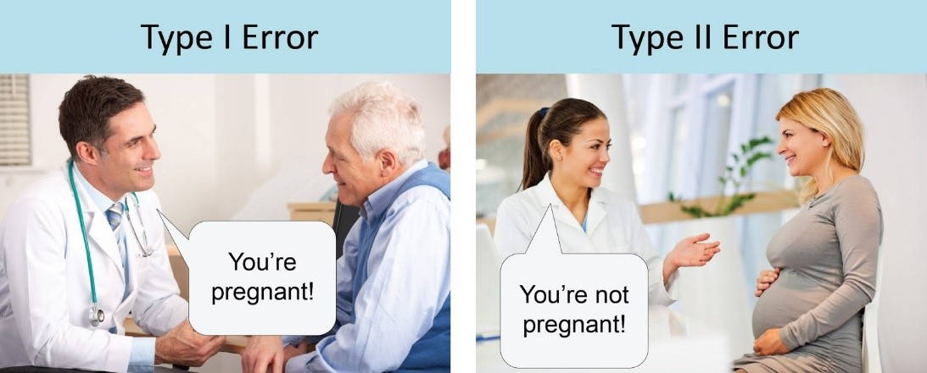
Type of Error

Slide 57
Overfitting
One of the biggest problems with decision trees is Overfitting
Consider error of hypothesis h over
Training data: error_{train}(h)
Entire distribution D of data: error_{D}(h)
Hypothesis h∈H overfits training data if there is an alternative hypothesis h’∈H such that
error_{train}(h) < error_{train}(h’)
and
error_{D}(h) > error_{D}(h’)

Slide 58
What is bias, variance trade off ?
Bias:
“Bias is error introduced in your model due to over simplification of machine learning algorithm.”
It can lead to under fitting. When you train your model at that time model makes simplified assumptions to make the target function easier to understand.
Low bias machine learning algorithms — Decision Trees, k-NN and SVM
High bias machine learning algorithms — Linear Regression, Logistic Regression

Slide 59
What is bias, variance trade off ?
Variance:
“Variance is error introduced in your model due to complex machine learning algorithm, your model learns noise also from the training data set and performs bad on test data set.”
It can lead high sensitivity and over fitting.
Normally, as you increase the complexity of your model, you will see a reduction in error due to lower bias in the model.
However, this only happens till a particular point. As you continue to make your model more complex, you end up over-fitting your model and hence your model will start suffering from high variance.

Slide 60
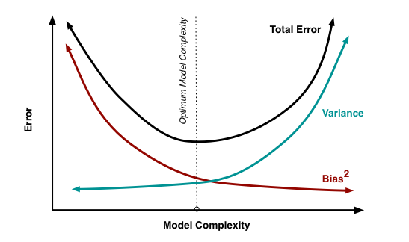
Bias, Variance Trade off …

Slide 61
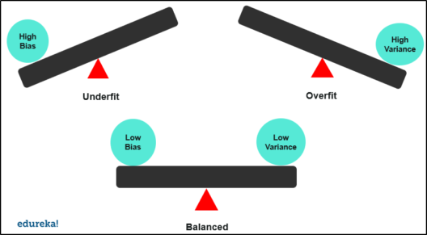
Bias, Variance Trade off …

Slide 62
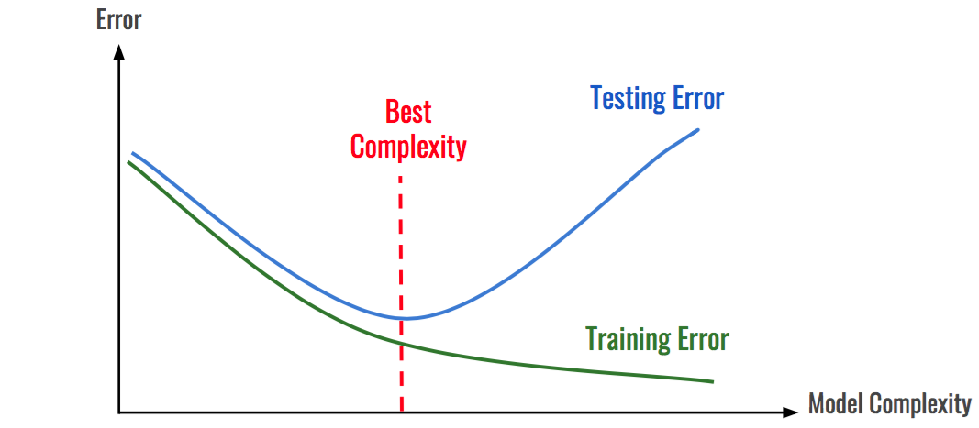
Overfitting …

Slide 63
Bias, Variance Trade off …
The goal of any supervised machine learning algorithm is to have low bias and low variance to achieve good prediction performance.
The k-nearest neighbours algorithm has low bias and high variance, but the trade-off can be changed by increasing the value of k which increases the number of neighbours that contribute to the prediction and in turn increases the bias of the model.
The support vector machine algorithm has low bias and high variance, but the trade-off can be changed by increasing the C parameter that influences the number of violations of the margin allowed in the training data which increases the bias but decreases the variance.
There is no escaping the relationship between bias and variance in machine learning. Increasing the bias will decrease the variance. Increasing the variance will decrease the bias.

Slide 64
Quiz
1. It is a measure of how close measurements come to each other when they are made in the same way
A. Error
B. Accuracy
C. Precision
D. Extrapolation
Ans-C Precision

Slide 65
Question 1: Which of the following pairs of metrics is plotted to form a Receiver Operating Characteristic (ROC) curve, and what does the False Positive Rate (FPR) represent?
Options: A. Precision vs. Recall; FPR = FP / (FP + TP) B. True Positive Rate vs. False Positive Rate; FPR = FP / (FP + TN) C. Sensitivity vs. Specificity; FPR = TP / (TP + FN) D. Accuracy vs. Error Rate; FPR = FN / (TN + FP)
Correct Answer: B. True Positive Rate vs. False Positive Rate; FPR = FP / (FP + TN)
Question 2: Which of the following statements best describes the bias-variance trade-off in supervised machine learning?
Options: A. High bias and high variance always lead to optimal generalization B. Increasing model complexity increases bias but reduces variance C. Reducing bias often increases variance, and reducing variance often increases bias D. Bias and variance are unrelated and can be minimized independently
Correct Answer: C. Reducing bias often increases variance, and reducing variance often increases bias

Slide 66
Quiz
2. Three different people weigh a standard mass of 2.00 g on the same balance. Each person obtains a reading of exactly 7.32 g for the mass of the standard. These results imply that the balance that was used is:
A. Both accurate and precise
B. Neither accurate nor precise
C. Precise but not accurate
D. Accurate but not precise
Ans- C-Precise but not accurate.

Slide 67
Quiz
3. Which of the following cross validation versions may not be suitable for very large datasets with hundreds of thousands of samples?
A) k-fold cross-validation
B) Leave-one-out cross-validation
C) Holdout method
D) All of the above
Ans- B

Slide 68

Any Questions ?

